Slide 1
PEOPLE | PROCESS | TECHNOLOGY

Slide 2
ABOUT BUCHANAN TECHNOLOGIES
Buchanan Technologies is an international IT professional services, consulting and outsourcing company founded in 1988. We have grown from our humble beginnings into a respected leader in the IT services segment. We offer end-to end technology solutions for clients. We are committed to delivering cutting edge solutions and creating extremely satisfied customers.
To deliver on this promise, the company employs hundreds of Subject Matter Experts (SMEs) assisting clients with services such as technology maturity assessments, remediation services, software selection and implementation, custom application development, e-commerce solutions and website development, network security management, project implementation, VOIP, Cisco services, and full-service outsourcing.
Buchanan Technologies employs the best and brightest in the technology field, backs them up with proven processes, and maintains an overall focus on the business relationship we have with our clients.
Our clients range from local and regional companies to large scale global enterprises. We provide the perfect combination of people, process, and technology. Ask us for references. You’ll find our customers stay with us, because we deliver results and stand behind our work. Through detailed reporting, professional best practices, and guaranteed service levels, Buchanan Technologies continues to grow and enjoy lasting relationships with its customers.
We have regional offices in the US, Canada, Europe, and Asia along with an extensive network of local affiliates in almost every city in North America. This enables us to deliver our services anywhere our clients are located. At the heart of our success is the practice of working closely with our clients to provide creative, strategic, and development services that assist them in meeting their business objectives.

Slide 3
WHAT WE DO
For 22 years, Buchanan Technologies has been in the business of helping customers solve business problems through the use of people, process and technology.
As the landscape of applications, infrastructure, and network management changes, we continue to grow and adapt through a pursuit of knowledge and expertise.
We develop strong and beneficial alliances with key technology vendors. These relationships pay dividends to our customers by giving us direct technical support, inside and advance knowledge of upcoming releases, and preferential pricing.
With 550 employees worldwide, spanning 7 times zones, and four 24x7 support centers, Buchanan is strategically positioned to meet your organizations evolving IT demands.
WHO WE ARE
At Buchanan Technologies it is important to know what that company is all about: What products the company sells; what services it offers; what the company does. But, it is equally important to know who the company is: What are the company’s values? What is the company vision? What direction is this company moving toward?
Our people are our most important and valuable asset. We passionately pursue trust relationships with our employees, partners, and customers. We work to ensure the success of our company by ensuring the success of our employees. Buchanan Technologies constantly offers opportunities to our employees, such as education services and industry certifications. We provide the proven skill and industry knowledge to our clients, ensuring high-level and low-cost solutions.
Buchanan’s primary focus is directly on the people we hire to serve the companies we support. No matter where you are located or what your challenge is, Buchanan Technologies’ team can help embrace your goals.

Slide 4
OUR VALUES
People Matter
At Buchanan Technologies, our people are our most valuable asset. We passionately pursue trust relationships with our people and we reward hard work and encourage and enable our people to achieve their goals through Servant Leadership. We celebrate individuality. Each individual contributes differently to build a diverse work environment filled with an abundance of skills, talents, knowledge, and creativity.
We encourage lifestyle balance because we all work to live.
Customers Matter
We love our customers.
We want insanely happy customers. Happy customers are satisfied for the moment, whereas insanely happy customers build lifelong relationships. We over-deliver on our promises. An abundantly satisfied customer is our greatest marketing tool. Abundant satisfaction is a result of trust. Trust is at the heart of every successful customer relationship.
Principles Matter
We stand on principle and integrity in everything we do. There is no substitute for integrity. It takes years to build and only a moment to destroy.
Do the right thing, at the right time, for the right reason.
Community Matters
One of our proudest traditions has been our community service. Our employees make a difference through the donation of their time, talents, and resources. We have an obligation to reach out to our communities at large and actively help where help is needed.
We can, we do, and we will make a difference.
Values are those internal emotions and core beliefs that set the tone for how we will act and what motivates us to take action. Our values help us determine what matters.

Slide 5
OUR VISION
We strive to be: The Preferred Employer
Buchanan Technologies is a place where people grow and thrive.
Our culture is simultaneously fun and challenging.
We enable and celebrate personal achievement.
Our people are equipped for success with knowledge, information, and tools.
Our company believes in Servant Leadership.
We strive to be: The Preferred Business Partner
Our customers and alliances trust us, and we never take that for granted.
We deliver transformational services through the technical leadership, innovation, and knowledge capital of our people.
We have a stake in every relationship. We share the risk and invest resources to create the reward.
Our customers can depend on us to be good stewards of their investment. They know we practice integrity in all of our business dealings.
We encourage our employees to actively pursue their personal, financial and career goals. Choose a direction, focus on your goals, and we will help you attain them
Vision is organizing and operating in such a way that we continuously live out our values.

Slide 6
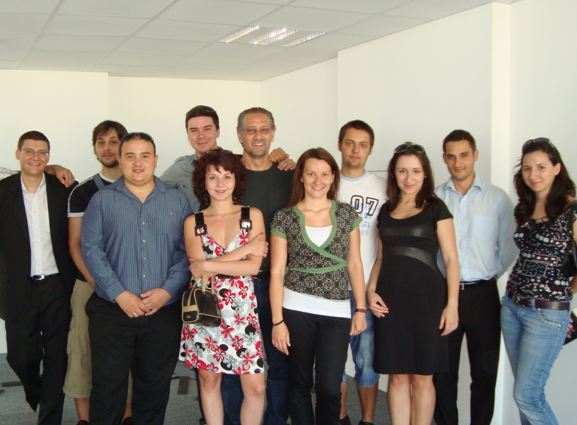
SERVANT LEADERSHIP
Servant Leadership is a practical philosophy which supports people who choose to serve first and then lead as a way of expanding service to individuals and institutions.
Servant leaders encourage collaboration, trust, foresight, and listening; they teach through example, consistent feedback, and personal guidance.
Servant Leadership means that it is each person’s
responsibility to be a leader, to set a positive
influence, and educate through example. This is how we all grow and this is BA culture.
OUR DIRECTION
Direction, these are the short-term, specific and measurable actions, or initiatives, that we take to support our business.
Proactive Employee Communication
Improvement of Employee-Focused Programs
Servant Leadership Development
Spreading of Buchanan Technologies Culture
Development of Empowering Processes
We encourage our employees to actively pursue their personal, financial and career goals. Choose a direction, focus on your goals, and we will help you attain them.

Slide 7
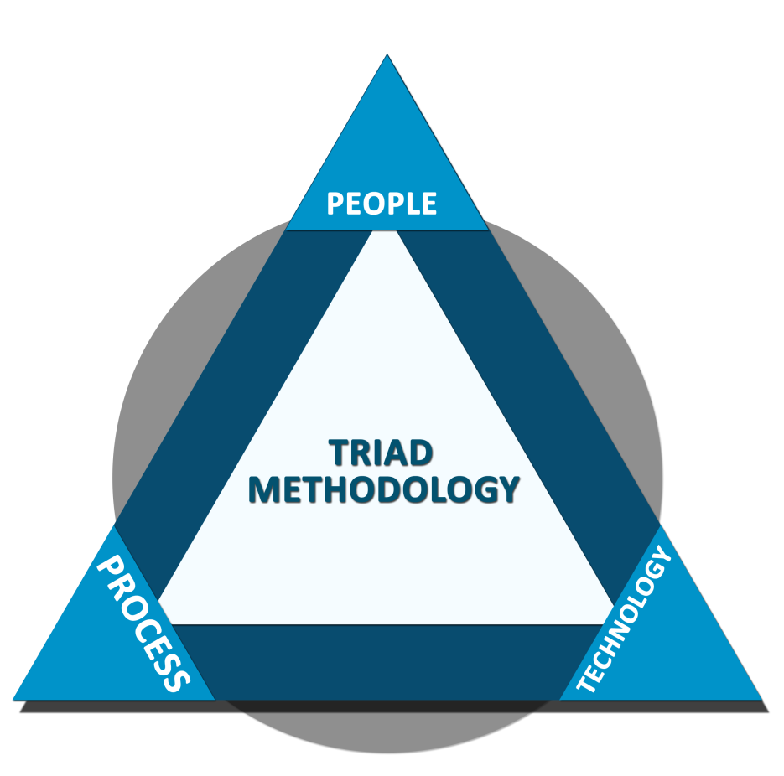
PEOPLE|PROCESS|TECHNOLOGY
TRIAD Methodology
The successful blend of interpersonal communication skills, effective project management and technical ability is incredibly powerful. The TRIAD© Methodology maps an individual’s capabilities to create teams that are effective and efficient.
Projects are mapped into the TRIAD© Methodology to ensure effective communication and training plans. Project management will keep people aware of the progress of the project and the skill to get the job done.
When the TRIAD© Methodology is applied to a customer relationship, the strength of both the customer and BA grows, thus combining the embedded knowledge of our customers and processes to achieve a high value return with fundamental IT management.
People
Buchanan hand picks only the brightest talent on the market. The right people with the right skills.
Process
Best practices are proven processes. Buchanan uses methodologies such as ITIL and Century to support customers’ business processes.
Technology
Buchanan uses industry standard as well as proprietary technologies to keep our customers secure, stable, and efficient.

Slide 8
CIO & WORKFORCE MANAGEMENT
Buchanan CIO Partners is a partnership of career Chief Information Officers providing innovative CIO services to emerging companies, middle-market companies, and large corporations. Having a Buchanan CIO Partner as a strategic member of an executive team is a unique value proposition, reducing the cost and risk of an individual hire while providing access to the extensive intellectual capital resources of the partnership.
Not only does the Partner serve as a dedicated and trusted advisor on the design, purchase, and deployment of information systems technology and services, but is supported by all other experienced Buchanan CIO Partners around the country who continuously share knowledge, experiences, and best practices.
We provide executive leadership to companies in the management of their information systems function. We call our value proposition The CIO Answer, it is an alternative, flexible, responsive approach to a company's human capital requirements for setting corporate technology strategy and leading important change initiatives involving technology-enabled information systems. A Buchanan CIO Partner may be employed by the client as a full-time, interim, or part-time Chief Information Officer or serve an executive role on a specific project basis.

Slide 9
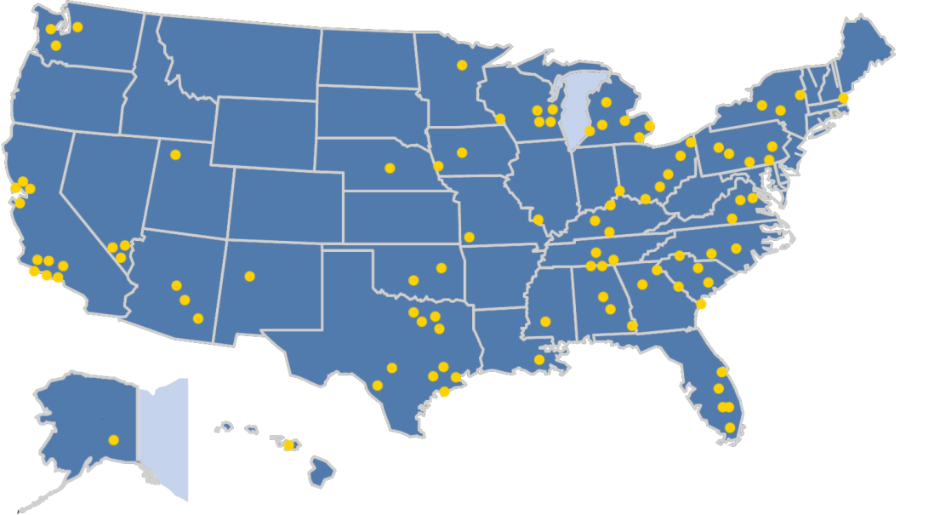
FIELD ENGINEERING SERVICES
Buchanan’s Field Engineering Service Team spans the U.S., with hundreds of highly trained IT professionals. Our engineers have been responsible for thousands of implementations and refresh deployments for the following sectors:
Buchanan proactively manages our engineers’ educational requirements, ensuring they are best-prepared to deliver the highest quality support to our valued clients.
Government
Automotive
Finance
Retail
Aviation
Education
Transportation
Healthcare
Communications
Non-Profit
Buchanan Field Services

Slide 10
OUR PARTNERS
Microsoft Gold Partner
Buchanan Technologies is a Microsoft Gold Partner with expertise in the latest Microsoft technologies including SQL 2005, Exchange 2007, Windows 2003, Windows 2007, Windows Vista, Windows Mobile, Sharepoint, and other MS technologies.
Premiere Cisco Partner
As a Premier Cisco Partner, we offer expertise in Routers, Switches, Wireless, CiscoWorks, Security, VOIP and CallManager. Buchanan Technologies also procures Cisco equipment to customers while offering the highest discounts.
VMware VAC Partner
Buchanan Technologies is a VMware VAC Partner in the Untied States & Canada providing a full compliment of VMware related expertise. From large datacenter consolidations, to small business virtualization assessments, we can provide our customers with VMware expertise to increase hardware efficiency, while reducing total cost of ownership. The Managed Service delivery team of Buchanan Technologies leverages the latest technology from VMware to architect a solution that provides server consolidation, scalability, reliability, and predictable operational expense.
Dell Professional Services
Buchanan Technologies is a preferred partner for Dell Professional Services in both the United States & Canada. When customers engage Dell Professional Services for technology engagements, Dell relies on Buchanan to provide all facets of delivery from scoping and assessments to implementation and support. Through this partnership Buchanan delivers a full suite of services to include infrastructure based architecture and migration projects. Projects are focused on Microsoft, VMWare, Altiris and Oracle technologies.
Citrix Partner
Citrix and Buchanan Technologies enable enterprises to minimize the cost of application delivery while maximizing availability and security. This is done by delivering applications with a unified infrastructure capable of accelerating business growth, while mitigating risk, and reducing costs.
IBM Global Premiere Partner Buchanan Technologies is an IBM Global Services Premier partner. Through this partnership Buchanan Technologies delivers application development, VOIP, and managed services solutions for IBM customers throughout North America.
Oracle Partner
Buchanan Technologies has Oracle expertise that is second to none. We employ some of the brightest Oracle & Linux talent available in the marketplace. These consultants have helped our customers with Oracle migrations from Sun and HP hardware with Solaris and AIX operating systems to Dell hardware and Linux operating systems. Our consultants are versed with the Oracle Database technologies and line of products, so that we may help customers with single stand alone Oracle environments that need a more robust, fault tolerant database solution; migrate to a Clustered Oracle RAC (Real Application Cluster) environment. Our consultants are skilled in the Database migration techniques and technologies to assist our customers in the migration of data from one Oracle version to another.

Slide 11
OUR PARTNERS
Peak 10 Solutions Partner
Buchanan Technologies is a partner for data centers and application hosting with Peak 10. This partnership provides our customers with local solutions for outsourcing data center services. These solutions help lowers costs and maximize internal resources, all while keeping valuable information technology assets close to your business.
AT&T Partner
Buchanan Technologies is currently a resell partner to AT&T for voice and data circuits, as well as the AT&T VOIP plug and play phone systems. This partnership can provide support and pricing anywhere in the US.
Hewlett-Packard Partner
Buchanan Technologies is currently a selected Business Partner of HP and part of the HP PartnerONE program. Through this partner program, we can resell and deliver HP products and solutions that match our customers’ needs. With the PartnerONE Program, we can find the right HP product and solution in a fast and accurate manner. The program is structured to work across all HP business units and organizations to help us quickly identify and present the right match for our customers’ needs.

Slide 12
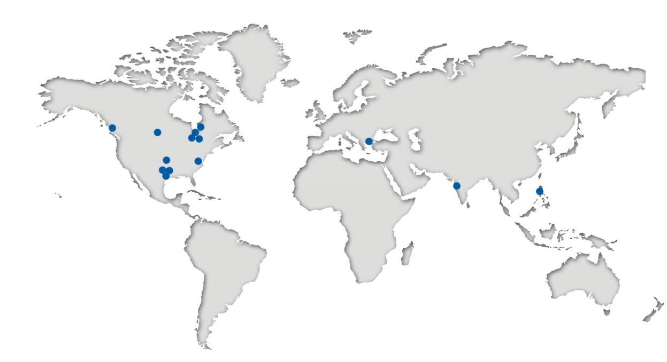
BUCHANAN TECHNOLOGIES
Within a world of choices, Buchanan Technologies has distinguished itself as a preferred provider of information technology services. We have been delivering services to business customers since 1988 and enjoy steady growth and long-standing client relationships.
Buchanan Technologies specializes in improving business processes and solving problems using technology and services, such as consulting, design, project implementation, network security, service desk support, application development and managed services.
Buchanan Technologies is headquartered in Irving, Texas, with regional offices in the U.S. and Canada. We also have affiliates in every major city in the U.S. and throughout Europe.
Buchanan Technologies’ Offices
USA
Irving, TX
Fort Worth, TX
Houston, TX
Austin, TX
Charlotte, NC
Miamisburg, OH
Bloomington, IL
Detroit, MI
Wichita, KS
EUROPE
Sofia, Bulgaria
ASIA
Mumbai, India
Manila, Philippines
CANADA
Toronto, ON
Calgary, AB
Vancouver, BC

Slide 13
OVERVIEW
Desktop Services
24 x 7 International Support Center
Application Development Services
Infrastructure Services
Managed Services
Managed Print Services
Enterprise Resource Planning (ERP)
Manage IT
Our Products (Powered by Clickright)

Slide 14
DESKTOP SERVICES
Providing a stable, consistent computing environment for your end-users is critical to the success of your business. We provide a team that has the experience, resources and abilities to offer our clients increased productivity, reduced costs and improved end-user satisfaction. We ultimately allow you to focus on your core business objectives
Buchanan’s Desktop Services Include the Following Key Service Offerings:
Onsite Field Services throughout the U.S.
Remote Control
Computer Audit & Inventory
Patch Management
Cross Platform Support (PC and Mac)
Hardware and software installation and maintenance
Windows roll-out planning and deployment
Microsoft Office roll-out planning and deployment
Distributed systems management
On-site and Off-site 1-800 support services for desktop applications and server management
2nd and 3rd level support services
Mobile Device Support
End-User Security
Anti-virus and Anti-Spam Support
Help Desk Support (24 x 7 International Service Desk)
Our Desktop service team provides 1-800 support services to our clients through our 24 x 7 International Support Center.

Slide 15
DESKTOP SERVICES
Secure Remote Control
Buchanan Technologies’ Remote Control Service can provide easy, fast and secure Remote Desktop Management of your entire computing infrastructure from anywhere.
Computer Audit and Inventory
Buchanan provides a fast, accurate and up-to-date Audit and Discovery of the entire computing infrastructure, allowing customers to get a complete and comprehensive software and hardware inventory delivered right to their desktops automatically.
Patch Management
Buchanan provides fast, easy, and reliable patch management to keep our customers’ servers, workstations and remote computers up-to-date with the latest security patches and updates.
Automatic and Recurring Patch Scans
Easy and Fast Deployment
Patch Approval
Automated Patch Deployment
Interactive Patch Management
Flexible Configuration
Comprehensive Reports
Desktop Deployment Services
Create and maintain standard and/or departmental images for multiple hardware types to deliver a consistent, repeatable computing environment for the end-user
Automated deployment of software and Windows OS
Packaging of software installations for consistency of installation
Methodology and project planning for large scale deployments of multiple systems
Desktop Management Services
Process improvements and analysis to increase efficiencies and align the delivery of PC's and desktop services with the needs of your business
Documentation of processes, procedures and policies as related to the desktop services arena
Advanced Mobile Device Support
iPhone
Blackberry
SmartPhone
Windows CE devices (including scanners etc.), Wireless printers, etc.
Configuration and support, troubleshooting, coordination with vendors for RMA of faulty devices, integration with email and calendaring services
Real-time End-User Security
OS security patching and service pack updates
Office security updates, security updates for software
Coordination with server personnel for back end integration and deployment of system policies to mitigate risks
Ongoing Anti-Virus and Anti-Spam Support
Installation and configuration of AV and anti-spam tools
Management and tracking of system status through toolsets for enterprise products
Identification and remediation of virus and spyware attacks
Configuration of standard images to reduce risks associated with viruses, spyware and spam

Slide 16
24 X 7 INTERNATIONAL SUPPORT CENTER
The ISC works to minimize disruption to your business by detecting incidents, capturing the detail, and resolving the issue at every possible opportunity. If the incident cannot not be resolved directly or immediately, the team will coordinate the activity required to restore services while recording information that will result in the timely resolution and future prevention of problems.
Service Desk Consulting & Implementation
Our team of service desk professionals supports all sizes and types of call center operations. Our engagement model gives our management organization the visibility to many call centers supporting hundreds of thousands of employees and their various methods of service delivery.
Service desk design, implementation, and operation
Service desk technology recommendations
Service desk assessments
If you’re interested in improving your delivery of service, consider Buchanan Technologies’ ISC Service Desk consulting engagement. We’ll help you understand how to improve your service desk and make recommendations to improve its efficiency and the customer experience.
Managed Service Desk
Buchanan Technologies delivers a managed service
desk solution that integrates with your
IT infrastructure. Our service desk professionals give your employees and customers great customer service and provide a solution when they need it most. Buchanan leverages industry best practices, such as Information Technology Infrastructure Library (ITIL), Help Desk Institute (HDI), and Project Management (PMI) to identify root causes and develop the service desk solution that drives down the number of trouble ticket incidents, reduces downtime, and assists improving the ultimate customer experience.
Buchanan Technologies works with you to lower costs, improve customer service, reduce management headaches and improve your business operations. Our goal is to minimize disruption to your business by detecting incidents, capturing the detail, and resolving the issue at every possible opportunity. If the incident cannot be resolved immediately, the team coordinates the activity required to restore services. Our documentation will help maintain a timely resolution and support the analysis to show how to prevent similar issues in the future.
We help our customers minimize disruptions to business while showing performance measurements, not just workload measurements. Some key benefits of working with us include:
Lower overall costs
Access to support 24 hours every day, 7 days a week
Ongoing analysis and recommendations on improving business processes based on trend analysis
Our 24 x 7 services help our customers do their jobs knowing there is qualified support just a phone call away

Slide 17
24 X 7 INTERNATIONAL SUPPORT CENTER
Maintain the Integrity of your Enterprise Knowledge
Enterprise knowledge is collected and maintained within SOCRATES, Buchanan’s knowledge management system. Periodic review of the knowledgebase updates and maintains changes to your organization’s information.
Teams meet regularly with managers to review knowledgebase information, learn about new initiatives, and get team performance feedback.
Outside the Box – Business Process Support
Use the service desk to support the new hire process, travel requests, and procurement requests in addition to technology support.
Quick Implementation
Our People | Process | Technology delivery methodology ensures successful implementation that is reliable, dependable and predictable.
ISC Products & Tools CTS Service Center
Incident Management
Request Management
Problem Management
Change Management
Socrates Knowledgebase Management System
Skills Management System
Apollo Learning Management System
Deep Dive Analytics Help You Make Effective Process Improvements
Understand where your business needs support and what trends might lead to a greater need for training or technology upgrades. Our sophisticated data tracking and consultative reporting gives you a basis for making strategic business decisions. Our reporting package includes:
Accomplishments/goals/interruptions
Automated Call distribution Statistics
Twelve-month ticket trends
Aging History
Aging by Group
Ticket Ratings
Resolution Rates
Response and Resolve Times
Ticket Origin

Slide 18
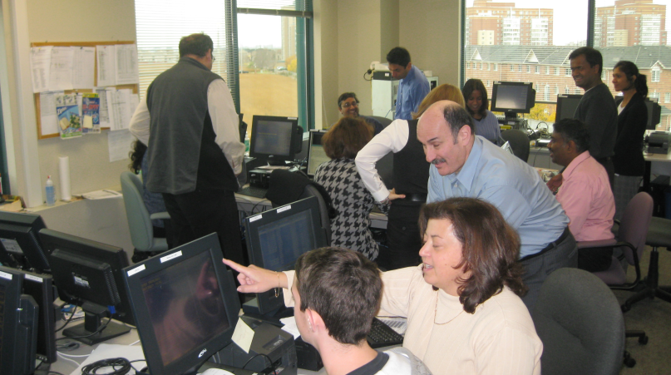
APPLICATION DEVELOPMENT SERVICES
In today's world, companies are developing custom applications to meet their business needs. Companies utilize their existing technical staff or outsource their core development to a trusted partner, like Buchanan Technologies. Whichever approach is chosen, it is critical for organizations to design, develop and deploy their applications with minimal risk and in the most cost effective and timely manner possible.
Gain the benefits of your software development project faster and eliminate cost overruns by employing professional developers and projects managers from Buchanan Technologies. By managing to specific deliverables and outcomes, or working as part of a client-managed team, your Buchanan Technologies application development team guarantees your success.
Let us demonstrate our experience in automating business processes, integrating disparate systems and building collaborative solutions.
The Buchanan Technologies Application Development Center (ADC), can enhance and improve the efficiency of your business operations by designing, deploying and supporting custom and packaged applications. Using our proven development and testing methodology, we reduce client risk and deliver cost effective solutions. By utilizing the Application Development Center facilities, Buchanan Technologies helps its clients eliminate the costs of building and maintaining development environments.
Custom Application Development Get access to in-depth technical and project management experience for all facets of your custom application development lifecycle. Using our Solution Delivery Methodology, we help clients through the process of designing, implementing, deploying and supporting custom solutions in the .NET, JAVA and POS technology space. And we have experience in large and small organizations across multiple industry verticals.
Our proven approach is built around the following:
Solution Delivery Experience. Broad experience in delivering custom development solutions and packaged application deployments to meet our clients' needs.
Proven Methodology. A best practice based methodology designed to reduce risk and deliver quality solution that meets your requirements.
Our People. Our architects and developers are experts in leading software products with the certifications and industry experience to prove it.
Cost Effective Solutions. Our clients have realized up to a 40% cost savings when utilizing our Application Development Center.

Slide 19
APPLICATION DEVELOPMENT SERVICES
Microsoft Application Development
As a Microsoft Gold Partner, we have extensive experience in designing and deploying Microsoft Packaged Applications. Many of our clients are using our services to design and Deploy .NET and Microsoft Office SharePoint Server 2007 (MOSS) into their organizations. Our experience includes designing and deploying MOSS Infrastructures, Custom MOSS Enterprise Rollouts, MOSS Training and the development of MOSS Governance Models. Ask us for information on the new SharePoint Server 2010.
Proven People—Experienced, Certified, Disciplined Project Teams
Your application development team is made of project managers, solutions architects, developers and quality assurance testers who have real-world experience creating custom solutions with leading edge technologies. Our people continually develop both their technical and professional skills through training and certification programs; and maintain their certifications to give our development projects the most current experience possible.
Proven Methodology—A Pragmatic, Phased Approach to Meeting Objectives
The key to successful application development is a proven, repeatable Methodology, guiding the application development lifecycle from
inception to completion. The Buchanan Technologies' Solution Delivery
Methodology relies on industry standards and best practices grained through years of delivering application development projects.
The Buchanan Technologies Solution Delivery methodology consists of seven phases: Discover, Design, Develop, Validate, Deploy, Transition, and Support.
Each of these phases has a defined set of milestones that must be reached before the next phase in the project begins.
Managing and mitigating project risk is critical to the success of any project. The Buchanan Technologies' Solution Delivery Methodology takes a proactive approach to risk management. Our methodology promotes proactive communication between the client and the project team through project status reports, risk logs, issue logs, and change requests -- all which are communicated and provided to the client on a weekly basis via written reports and status meetings.
Our method is unique in that it supports both infrastructure and application development projects. What makes an effective project methodology? Clearly defined objectives, action plans, and deliverables. Our methodology includes a seven phase process:

Slide 20
INFRASTRUCTURE SERVICES
Our certified professionals work with you on implementing the appropriate processes, technologies and staff to meet specific business requirements. Using industry proven methodologies and support tools, we give you a foundation for your mission critical applications. We guarantee a robust delivery model and cost-effective monitoring and management by leveraging our people, processes and technologies.
Our networking solutions provide advanced networking features while controlling costs by utilizing the most current technology combined with best practices in the areas of routing and switching, IP Telephony, and network security.
Core foundations for essential infrastructure management
Buchanan Technologies builds its clients’ infrastructure designs using industry standard platforms. Ask us for information on these key services.
Monitoring and Management for constantly changing environments Rely on our team of network professionals to monitor and respond to issues that arise within your infrastructure. Remote and onsite support assures availability and gives you advance notification of changing capacity and utilization requirements.
Our networking solutions provide advanced networking features while controlling costs by utilizing the most current technology including third-party monitoring applications.
Storage solutions to keep valuable data safe and available
Your business needs cost-effective storage solutions that easily permit you to address backup, recovery, assessments, architecture, archiving, and risk management. Buchanan Technologies offers storage services that give you stress-free solutions with dramatic cost reductions.
Backup & recovery solutions
Storage assessment
Storage architecture and planning
Directory Services
Active Directory
eDirectory
Identity Management
Single Sign-On Products
Virtualization
Hyper-V
VMWare
Citrix/Xenserver
Routing and Switching
Cisco
Juniper
Server Platforms
Linux
Microsoft
AS 400
3270 Mainframe

Slide 21
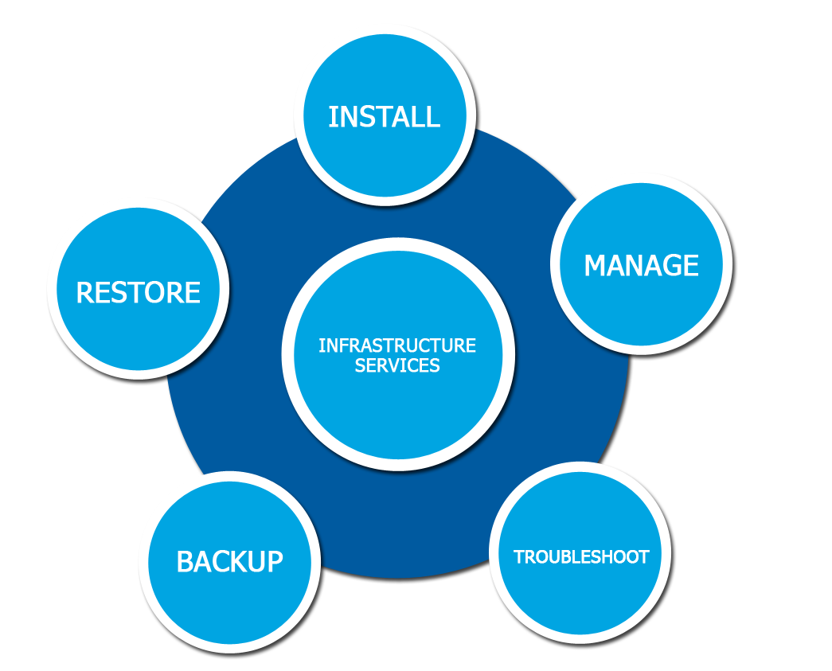
INFRASTRUCTURE SERVICES
Switching & Routing
Buchanan Technologies’ Routing and Switching specialists have the proven skills and knowledge required to successfully install, configure, monitor, and support the advanced capabilities of Cisco routing and switching solutions. Our specialists have specific expertise in:
Routers
Switches
Wireless
CiscoWorks
WAN optimization
Security
VOIP
Call Manager
Messaging to keep your enterprise connected
Communication is the key to personal and business success. Effective and dependable communication through email and other sources is a vital factor in both employee and customer relations. Buchanan's Messaging services employ state-of-the-industry solutions across existing and emerging platforms, including:
Exchange, Notes, Groupewise, Open Source
Unified Messaging: OCS/LCS, CUP
Sharepoint

Slide 22
MANAGED SERVICES
Buchanan Technologies’ Managed Services provides clients with IT Management Services that lead to increased security and stability while lowering the cost of system maintenance and administration.
By leveraging 22 years of IT consulting expertise and robust operational efficiency model, Buchanan Technologies will provide a high level support and availability by managing your networked equipment and applications. Buchanan enables customers to focus on strategic activities rather than device support. In addition, establishing a partnership with Buchanan will allow you to pay only for the support services that are really needed, which enables personnel and financial resources to focus on core business initiatives.
Our proactive management of operations ensures issues which arise are quickly resolved, ensuring uptime and end-user satisfaction are enhanced.
Buchanan’s Managed Services
24 x 7 x 365 Helpdesk Support
Desktop & Network Security Solutions
Hardware and Software Installation; Lifecycle Management
Remote Desktop Management
Onsite Support Services
Managed Print Services
Hardware Asset Management
Vendor Relationship Management
Infrastructure Management
Spam Protection
Data Protection and Backup
Security Patch Management
Benefits
Relevant & Timely IT Activity Reporting
Remote Monitoring
Proactive Maintenance and Monitoring on a 24x7x365 basis
IT Depot & Inventory Management
Defined Service levels
Break & Fix - Certified Hardware Technicians
Certified Warranty Claims
Warranty approval and repair/replace process
Fixed Costs
Lower operational budgets providing stronger return on investment to the business
Enhances uptime and infrastructure security and stability
Provides proactive infrastructure at a fraction of the cost
Enhances retention of senior technical talent by offloading redundant daily administration and operational tasks
Ensures full time technical resources are able to focus on strategic areas and technical direction rather than daily support-based activities
Supported Environments
Desktop & Server OS
Exchange Server
Blackberry servers
SQL server
SharePoint Server
Citrix Infrastructure
Backup Infrastructure
Virtual Server Environments

Slide 23
MANAGED PRINT SERVICES
Most organizations have dozens of printing devices scattered throughout one or multiple facilities. Companies may be using a mix of models and manufacturers, including new machines as well as legacy devices based on old technology. The cost per page for each device may be known, as well as what is spent on consumables and repair bills; but the immeasurable costs as a result of downtime, mishaps and maintenance on these devices can go unchecked, draining profits and putting an unnecessary burden on employees and IT staff.
Buchanan’s Managed Print Service can allow customers to focus on their core business and not the day-to-day management of printers, copiers, faxes, scanners and multi-function peripherals. With a managed print solution, companies can update and right-size the printer fleet to save internal resources and help reduce total cost of printing.
Establishing a leaner, more fluid printing infrastructure will provide your organization with opportunities to improve productivity and increase cost efficiency. Buchanan’s Managed Print Services utilizes various tools, hosting technologies, and a dedicated support center to enable our customers to achieve outstanding results and reduce costs. Most companies have to manage multiple vendors, contracts, and service level agreements, which can be costly and complex. Buchanan’s Managed Print Services provides single point of contact and accountability, allowing to gain control over a fragmented and decentralized imaging and printing environment. In addition, Buchanan’s Managed Print Services will focus on current asset infrastructure and apply proven methodologies and technologies to keep internal business processes running at peak performance.
Buchanan Technologies’ Managed Print also provides warranty response support and dispatches onsite Field Engineers for device maintenance and repair.
Managed Print Program Features
Track printer assets regardless of the brand
Report volume usage by printer
Replenish consumables through automatic toner fulfillment
Initiate service calls directly to a certified help desk agent
One monthly charge based on pages printed
Remote monitoring of all devices
Managed Print Benefits
Provides a single point of accountability
Helps reduce IT burden, allowing you to focus resources on core business
Helps reduce total print costs
Can help eliminate investments in capital equipment
Proactively manages print fleet to help reduce downtime
Helps eliminate the need to stock printer consumables on- premises
Onsite Field Support

Slide 24
ENTERPRISE RESOURCE PLANNING (ERP)
Buchanan Technologies is collaborating with Microsoft Partners to assist with implementation, development, project management and consulting services. Buchanan uses proven methodologies with a focus on business processes to provide ‘best practice’ solutions.
Buchanan’s ERP service can assist in efficiently integrating the data and processes of your organization into one single system, allowing easy access and workflow for the entire organization.
Benefits
Improved coordination across functional departments
Increased efficiency
Reduced operating costs
Reduced Personnel
Accuracy
Development
Buchanan Technologies have several developers and testers able to provide support in all areas of NAV. Our Continuous Integration model can provide companies with manageable development and testing processes, keeping the most current development in the production environment. In addition to NAV customizations, Buchanan has provided performance optimizations and development training. We have also provided support for Navision Application Server, Employee Portal and Business Analytics implementations.
Buchanan Technologies also has developers available for XML, Visual Basic.NET, C#, ASP.NET, Java, Python, Perl and many other programming languages.
Documentation Support
Documentation is an important and vital part of any successful implementation. Buchanan Technologies’ technical writers provide detailed user documentation for end users. We also provide comprehensive documentation for maintenance processes.
End-User Training
Buchanan Technologies can provide on-site or remote training NAV.
Implementation Support
Buchanan Technologies provides support for every aspect of implementation. We can provide a full implementation team or support for specific areas. In addition to the services described above, we provide expertise for:
Project Management
Data Migration
Infrastructure Management
“As-is” and “To-be” process flows
Module Support
Buchanan’s consultants are experienced with all Dynamics NAV modules including:
Finance – including Cost Accounting
Warehouse
Manufacturing
Purchasing
Sales & Marketing – including CRM
Human Resources & Payroll
Specific projects have included MRP implementation, permissions review and updates, and NAV CRM implementations.
Many of our consultants are also able to provide support for integration with other systems including the Gentran Translator (for non-Lanham EDI), Oracle, CRM and SQL.
Buchanan Technologies has extensive experience with EDI systems and can develop EDI Solutions for any translator without the need for Lanham EDI.

Slide 25
MANAGE IT
Tactical IT Director Functions
There are nine basic services that represent the basic management functions for most Information Technology: Service Desk, Change Management, Workstation Management, Infrastructure Management, Telecom Support, SOX Compliance, IT Procurement, Asset Management, and Security.
Workstation Management
Workstation management requires a wide range of tools and processes to be efficient and effective: Remote Control and Diagnostics, Migrations, Imaging, SW Distribution, Patch Management, Backup Services, Workstation Alert Monitoring, Asset Lifecycle Management, Antivirus, Security Base Analyzer, License Key Management, and Hardware Maintenance.
Infrastructure Management
It requires more complex tools and resources to streamline operational tasks: Migrations, SW Library, Network Monitoring, Server Backup, Server Monitoring, Patch Management, Security Management, Security Management, Security Monitoring, Asset Management, Antivirus, License Key Management, Server Diagnostics, Email Spam Filtering, Hardware Maintenance.
IT Audit Schedule
Scheduled tasks are required to ensure steady state operations. The IT Audit Schedule is designed to verify a report on the status of key IT functions: Backup Verification, Disaster Recovery, Patch Verification, Capacity Planning, Virus Verification, Security Audit.
IT Sourcebook
The IT Sourcebook is a key component of the IT infrastructure documenting all devices, interfaces, software, procedures and plans associated with Information Technology. Sourcebook Components include Hardware and Software Inventory, Network Maps, Policies and Procedures, Capacity Planning Statistics, Change and Problem, Incident Management, Call Tree, Vendor Information, and Contract Management.
Common Directory Structure
A Common Directory Structure provides the IT organization a central place to store information pertaining to Information Technology initiatives. A standard, published file system for IT increases a framework for the business to manage knowledge.
Manage IT, provides the people, the process, and the technology, along with audit schedules and sourcebook components and common directory structure to deliver a full complete IT solution.
Manage IT provides effective customer communication, the procedures and methodologies that are repeatable and measurable, and the subject matter expertise to successfully plan, implement, manage and report.

Slide 26
OUR PRODUCTS
powered by
Buchanan Technologies has developed a powerful, full suite of business applications use to support our clients' technology services, clickright.net. Clickright offers services including procurement, asset management, incident, problem, and change management.
ARIES—Asset Management System
ARIES gives immediate access to accurate information about every asset managed. The web-based, hosted software solution includes integrated software for handheld scanners. Have a fast, easy-to-use asset information capture tool as well as an enterprise-wide asset management and reporting system. Benefit by reducing hours spent searching and accounting for equipment. And auditing, reporting and managing maintenance, moves and depreciation of valuable assets is fast and easy.
Not only can ARIES track typical computer assets like laptops and monitors, it can manage furniture, tools, vehicles and equipment. ARIES greatly reduces time wasted searching for lost or misplaced assets.
ARIES improves accuracy for audits by providing immediate access to asset lifecycle and ownership. Asset use is optimized with ease by maintaining the asset data either through the handheld device,
wireless notepads, or PC workstations with a direct link to a fully functional website with comprehensive, flexible reporting.
Buchanan Laboratories (BL)
Buchanan Laboratories uses automated testing systems to rigorously test business applications, business systems, email systems, and voice mail systems. BL is a full service offering; providing the staff to write scripts, install and monitor it’s performance. Verify email is flowing inside and outside a network. Test the quality of voice recording in an email in standard PBXs or VOIP systems. Test production application performance. Test application functionality. It alerts customers to any issues 24 x 7.
Developing software? If so, consider using Buchanan Labs to perform regression testing to ensure existing functionality is working properly. Regression-testing lab performs a full regression test each time a new build of code is developed. Is there new functionality in the latest release? Include requirements documents and Buchanan will build new scripts to test if new software features are working as expected.
The system gives a deeper insight into systems through the use of multiple automated test labs and custom test reporting. Instead of manually testing software, Buchanan Labs gives the ability to schedule tests and receive results real-time.
FEATURES
Hand-held device software for Windows Mobile 5.0
Simple, web based user interface
Quick check in and check out feature for use with daily item changes
File uploading to attach files pictures, warranties, manuals, etc. to any asset
Unlimited assets and users
Custom fields perfect for tracking unique requirements, like grants or donations
Import and export to Microsoft Excel
Required fields and definitions for easy reporting
FEATURES
Wizards allow you to easily run scripts and view results.
The Dashboard shows progress and visual insight into automated labs.
Scheduling lets you set a specific time to start your automated test.

Slide 27
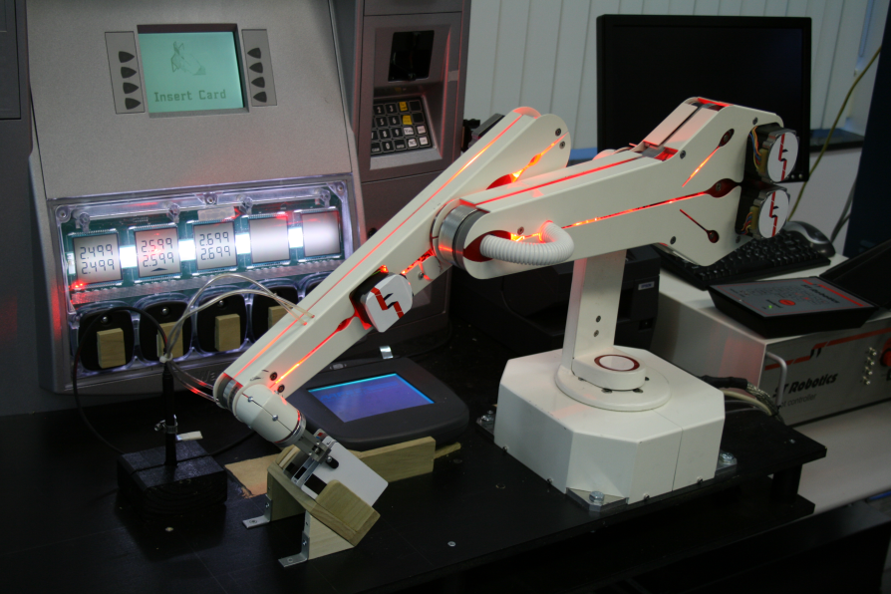
OUR PRODUCTS
powered by
FEATURES
Web-based
Variable Ticket Summary Screens: Easily view open, pending, closed, etc. tickets
Knowledgebase Management
Automatic email notification
Security: 24/7 third-party monitoring of all data access
Search: Comprehensive search capability
Search Data Export: Clicking the export hyperlink exports all data into excel spreadsheets
Role- Based Permission
Reports: Complete management and administration reports
Mail Integration: Attachments will be linked to the request
Self Serve: End users have the ability to create their own tickets as well as check on status of tickets.
Custom Fields
Escalation Rules
Recurring Tickets
Easy Client Information Display
Historical Information
Customization
CTS—Call Tracking System
CTS Service Center is a browser-based application that supports the comprehensive management of service desk services across incident tracking, problem resolution and escalation, and change management. CTS gives customers the ability for end-users to directly access functions through the Internet, including real-time viewing of service requests as well as an end user self-help system.
This enterprise-ready service desk ticketing system has been proved across a number of Fortune 1000 and medium-sized companies. The comprehensive system includes standard and advanced features, including easily viewed and managed tickets, auto-expanding ticket detail information; a knowledge-base management system, automatic email notifications; security through 24/7 third-party monitoring comprehensive search capability; role-based permission; as well as executive summary and detail reporting.
Buchanan Laboratories’ robotics

